Slide 1



2024 Procurement
Notes:
Thank you for joining the 2024 SREC Delaware Procurement webinar. My name is Bryan Gower, and I am the Program Manager for the SREC Delaware Program. This program is administered by InClime on behalf of Energize Delaware, also known as the Delaware Sustainable Energy Utility (DE SEU).
Today's webinar is designed for solar companies, solar industry professionals, and others who are already familiar with SRECs and the SREC Delaware Program.
If you are a homeowner or business owner submitting an application for the first time, I recommend attending our webinar tomorrow at 2:30 PM Eastern. That session will cover all the information from today’s webinar, along with a more general overview of SRECs and how the program works. You can register for tomorrow’s webinar by visiting our website at www.srecdelaware.com.

Slide 2
Agenda
Program Overview
Changes from 2023 Procurement
Program Requirements
Application Example
Questions & Answers
Notes:
Webinar Information and Agenda:
Recording Availability: This webinar will be recorded and posted on the 2024 procurement page of our website.
Who Should Attend: If you are a homeowner or business owner who already has an SREC Delaware contract, you do not need to attend this webinar unless you have installed additional panels since your application was accepted. If you have an existing contract and have not added new panels, the information presented today will not apply to your current contract.
Webinar Agenda:
We will begin with an overview of the SREC Delaware Program.
Next, we will discuss the changes between the 2023 and 2024 procurement processes.
We will then review the Program Requirements and walk through an application example.
Finally, we will conclude with a Q&A session. Please feel free to submit your questions throughout the webinar, but we will address them at the end.

Slide 3
Program Overview

Slide 4
General Overview
The State of Delaware established the SREC Delaware Procurement Program in 2011.
SREC Delaware procures SRECs for Delmarva Power so they can meet their requirements under the Delaware Renewable Portfolio Standard.
Each year a competitive procurement is held, and eligible projects can bid into the program.
Pay-as-you go, SRECs are purchased as they are generated.
Notes:
Here's the refined version of your script:
Overview of the SREC Delaware Procurement Program:
The State of Delaware established the SREC Delaware Procurement Program in 2011 to support Delmarva Power in meeting its requirements under the Delaware Renewable Portfolio Standard (RPS).
Each year, a competitive procurement process is held, allowing eligible solar projects to bid into the program.
The program operates on a pay-as-you-go basis, with SRECs purchased as they are generated.

Slide 5
General Overview
Bid Based Applications
  Competitively bid contracts- lowest prices will be accepted
Contracts Alpha, Beta & Gamma Tiers = 25 years
  First 10 years @ accepted bid price (plus DE parts / labor bonus)
  Final 15 years @ $10 / SREC (plus DE parts / labor bonus, as applicable)
Contracts Delta Tier =5 years
  5 years @ accepted bid price (plus DE parts / labor bonus, as applicable)
SRECs are purchased as they are generated.
If your application is successful, you or your customer will need to enter solar meter readings to receive payment for your SRECs.
Recommended to enter meter readings at least a few times a year.
Notes:
SREC Delaware is a bid based program. This means that contracts are awarded based on bid price. When you submit an application, you will provide information about the system, as well as provide a dollar amount that you would be willing to accept per SREC. The lowest bids in each tier will win contracts.
Four Tiers of Procurement:
Alpha Tier: Small and medium-scale, customer-owned in-state systems (≤350 kW).
Beta Tier: Large-scale in-state systems (>350 kW but ≤2 MW).
Gamma Tier: Discretionary purchases from systems up to 5 MW, including out-of-state systems and third-party SREC ownership.
Delta Tier (New for 2024): Large-scale in-state systems (>2 MW), with a 5-year contract term.
Contract Terms:
Alpha, Beta, and Gamma Tiers: 25-year contracts, compensated at auction price for the first 10 years, followed by $10 per SREC for the remaining 15 years.
Delta Tier: 5-year contract, compensated at the bid price for all five years.
Procurement Target:
Minimum: 11,000 SRECs.
Maximum: 31,000 SRECs.
Pricing Discretion: Delmarva can exercise price discretion in any tier, rejecting bids that exceed a set price. Non-winning bids cannot fill another tier.
If your application is successful, you or your customer will need to enter solar meter readings to receive payment for your SRECs.
It is recommended to enter meter readings at least a few times a year.
Before your system can begin generating SRECs, it must receive a Delaware Certification number. This certification verifies that your solar system meets the necessary requirements to produce SRECs eligible for sale in Delaware.
To obtain certification, you must submit an application to the Delaware Public Service Commission (DE PSC). Often, your solar installer may have already registered your system, so be sure to check with them first.
For more information on the certification process, please refer to our FAQ on applying for Delaware Certification.

Slide 6
Delaware Parts and Labor Bonuses
Bonuses available for systems that use DE labor, or have DE manufactured solar panels
10% parts and 10% labor bonuses apply to payments only
  Example: Successful bid at $30/SREC, with DE labor associated with the certification number, is paid $33/SREC for first 10 years
Eligibility for bonuses is confirmed by the Delaware Public Service Commission
Contract award preference for DE parts and labor in the event of a bid tie
Notes:
Bonuses for Delaware Labor and Parts:
Eligibility: Bonuses are available for solar systems that use Delaware labor or have solar panels manufactured in Delaware. However, since Delaware no longer manufactures solar parts, systems can only qualify for the Delaware parts bonus if they are existing installations or use older panels previously manufactured in the state.
Verification: Eligibility for these bonuses is confirmed by the Delaware Public Service Commission (DE PSC). System owners must provide the necessary documentation to verify eligibility, which will be noted in the system’s certification number once confirmed.
Bonus Calculation: If a system qualifies for either bonus, it will receive an additional 10% per SREC for each qualifying bonus.
Example: A successful bid at $30 per SREC with Delaware labor associated with the certification number would receive $33 per SREC for the first 10 years.
Bid Tie Preference: In the event of a bid tie, preference is given to bids with Delaware parts and labor.
Make sure to provide the necessary documentation to take full advantage of these bonuses.

Slide 7
Timeline
November 4th@ 9 am
Application window opens
November 15th @ 5 pm
Application window closes
Results announced
Once the results are announced, winning applicants will be sent
instructions on how to manage their contracts.
Notes:
Procurement Timeline:
Application Period: Applications will be accepted over a two-week period.
Results Announcement: Approximately one month after the application window closes, the procurement results will be announced.
Next Steps for Winners: Once the results are announced, successful applicants will receive instructions on how to manage their contracts.
Please keep these dates in mind and be prepared to follow the outlined steps if your bid is successful.

Slide 8
Tiers
Minimum of 11,000 SRECs procured - Maximum of 31,000 SRECs procured
New: systems with Interconnection Approval To Operate date of September 29th, 2023, or later.
Contract: 25-year contract structure remains the same for Alpha, Beta, and Gamma Tiers
Tier | Nameplate rating (DC at STC) | Description | Contract Term | #SRECs / Year
Alpha | ≤ 350 kW | Customer owned, new, in state | 25-year | 6,000
Beta | 350 kW ≤ 2 MW | New, in state | 25-year | 5,000
Gamma | < 5 MW | In state systems with 3rd party SREC ownership All existing systems Qualifying out of state systems | 25-year | 10,000
Delta | 2MW | New, in state | 5-year | 10,000
Notes:
The 2024 procurement consists of three tiers.
Delmarva intends to procure between 11,000 – 25,000 SRECs / year through this procurement.
Four Tiers of Procurement. To provide a brief summary of all the tiers:
Alpha Tier: Small and medium-scale, customer-owned in-state systems (≤350 kW).
Beta Tier: Large-scale in-state systems (>350 kW but ≤2 MW).
Gamma Tier: Discretionary purchases from systems up to 5 MW, including out-of-state systems and third-party SREC ownership.
Delta Tier (New for 2024): Large-scale in-state systems (>2 MW), In-State. Delta Toier contracts are awarded a 5-year contract term.
Bid Price Guidance:
Understanding Your Bid Price: When submitting a bid, your bid price is the dollar amount per SREC that you are willing to accept as payment.
Historical Context: In 2023, the average accepted bid price was $30.51 per SREC, which can serve as a reference point for this year's bidding.
Price Discretion and Rejection: Delmarva Power retains the right to exercise price discretion and may reject bids that do not meet their criteria. Additionally, any bids exceeding the Alternative Compliance Price of $150 will be automatically rejected.
Accessing Past Results: For more insights on past procurement results, please visit the specific procurement page on our website and scroll down to the 'Results' section.
Keep these factors in mind when determining your bid price to increase your chances of success.

Slide 9
Award Process
Step 1
Program Administrator reviews all applications
Step 2
Computer sorts bids low to high in each tier
Step 3
Lowest bids in each tier are awarded contracts
Notes:
Step-by-Step Bid Review Process:
Bid Review by Program Administrator: In the first step, the Program Administrator reviews all submitted bids. This includes verifying that the facility address is correct, ensuring the facility is not already enrolled in the SREC Delaware program, and confirming that the SREC commitment is reasonable based on the system size.
Bid Sorting: Next, a computer sorts all the bids from lowest to highest within each tier.
Contract Awards: Finally, the lowest bids in each tier are awarded contracts, ensuring that the most cost-effective bids are selected.

Slide 10
Award Process – Tie Scenario
Tie Scenario: if multiple bids at the same price oversubscribe a tier
Step 1
  Systems with DE Labor and Parts selected
Step 2
  If tie remains, winner determined by lottery among DE labor and parts systems only
Step 3
  If capacity remains, remaining projects given 5 days to revise their bid
Step 4
  Winners selected by lowest price revised bid
Step 5
  If tie remains, lottery conducted among DE labor or parts systems, then among systems without DE labor or parts (if needed)
Notes:
Handling Bid Ties in the SREC Procurement Process:
Occasionally, a tie can occur when multiple bids at the same price oversubscribe a tier. This means that two or more bids at the same price are competing for the final spot within that tier.
To minimize the chance of a tie, bids can be submitted in dollars and cents. Although tie scenarios have been rare, here’s how they will be managed if they do happen:
Tie Scenario: If multiple bids at the same price oversubscribe a tier, the following steps are taken:
Systems that utilize Delaware labor and/or Delaware parts are prioritized and will be selected over those without these bonuses.
If a tie still exists, the tied systems may be asked to submit revised bids.
Next Steps: If you need to rebid due to a tie, we will reach out to you directly with instructions.

Slide 11
Owner Representatives
Bids can be submitted by the owner of the system, or by an Owner Representative.
SREC owners or Owner Representatives can manage successful SREC contracts.
SREC owners can change or remove Owner Representative oversight at any time.
Some solar installation companies serve as owner representatives & submit customer applications, others require that customers submit their own applications.
Notes:
Bid Submission and Contract Management:
Who Can Submit Bids: Bids can be submitted by either the system owner or an Owner Representative.
Managing SREC Contracts: Both SREC owners and Owner Representatives have the ability to manage successful SREC contracts.
Changing Representatives: SREC owners have the flexibility to change or remove Owner Representative oversight at any time.
Role of Solar Companies: Some solar installation companies act as Owner Representatives and handle the application process for their customers, while others may require customers to submit their own applications.
Be sure to understand your options and the role of your representative in the process.

Slide 12
Other Important Notes
Delmarva has the right to exercise price discretion and reject bids
Bids above the Alternative Compliance Price of $150 will be automatically rejected
Diversity of Ownership in Alpha Tier: The SEU will not award more than 50% of SRECs in Alpha Tier to a single owner unless Alpha Tier is undersubscribed due to that limitation
Notes:
Bid Evaluation and Ownership Diversity Guidelines:
Price Discretion: Delmarva Power retains the right to exercise price discretion and may reject bids that do not align with their criteria.
Bid Rejection Threshold: Any bids above the Alternative Compliance Price of $150 will be automatically rejected.
Diversity of Ownership in Alpha Tier: To promote diversity, the SEU will not award more than 50% of the SRECs in the Alpha Tier to a single owner unless the Alpha Tier is undersubscribed as a result of this limitation.
These guidelines help maintain a fair and balanced procurement process.

Slide 13
Changes from the
2023 Procurement

Slide 14
Changes from 2023
New Delta Tier: Introduced to provide an option for large-scale (>2 MW) in-state projects with a shorter 5-year contract term, catering to developers seeking shorter-term price stability
Reduced Gamma Tier Volume: The discretionary target purchase volume for the Gamma Tier has been decreased from 14,000 SRECs in 2023 to 10,000 in 2024, reflecting low participation in the Gamma tier in the 2023 procurement
Notes:
New Delta Tier: Introduced to provide an option for large-scale (>2 MW) in-state projects with a shorter 5-year contract term, catering to developers seeking shorter-term price stability.
Reduced Gamma Tier Volume: The discretionary target volume for the Gamma Tier has been decreased from 14,000 SRECs in 2023 to 10,000 in 2024, reflecting low participation in the Gamma tier in the 2023 procurement
The 2024 program builds upon the 2023 Program's structure with adjustments to respond to market conditions and feedback.
The addition of the Delta Tier offers more flexibility, and the program aims to continue promoting a competitive and cost-effective solar energy market in Delaware.

Slide 15
Program Requirements

Slide 16
Basic Requirements
Projects must have or be eligible for DE certification
  Applicants are responsible for obtaining DE certification #s
  If you have not yet registered with the DE Public Service Commission (PSC), you can contact them at 302-736-7500 to learn more.
Projects must be operational within 12 months of contract award date
Projects under 500 kW must have revenue grade meters or revenue grade online monitoring
Projects 500 kW or greater must have revenue grade online monitoring
Notes:
Project Eligibility and Requirements:
Delaware Certification: Projects must have or be eligible for Delaware certification. It is the applicant’s responsibility to obtain a Delaware certification number.
Certification Process: If you have not yet registered with the Delaware Public Service Commission (PSC), you can contact them at 302-736-7500 for more information.
Operational Timeline: All projects must be operational within 12 months of the contract award date.
Metering Requirements:
Projects under 500 kW must have revenue-grade meters or revenue-grade online monitoring.
Projects 500 kW or greater must have revenue-grade online monitoring.
Adhering to these requirements is essential for participating in the program.

Slide 17
One Contract – Multiple Facilities
Applicants must aggregate facilities together under one contract if they:
  Are on the same parcel of land OR
  Share a utility interconnection point
Exceptions made for expansions to existing accepted applications
  To submit a new bid, expansions must (1) be separately metered, and (2) have a separate DE Certification number from the original system.
Notes:
Aggregation of Facilities Under One Contract:
Applicants must aggregate their facilities into a single contract if they:
Are located on the same parcel of land, OR
Share a utility interconnection point.
Exceptions may apply for expansions to existing accepted applications
Example for aggregating facilities into a single contract: If an office complex has multiple buildings, each with its own solar facility, these must be aggregated into one bid. After aggregation, you should contact customer service so adjustments can be made to ensure that each facility owner receives the correct number of SRECs from the shared contract.
Example for submitting an expantion as a new bid: To submit a new bid for an expantion on a parcel that has a contract awarded under a previous procurement, the expansion must (1) be separately metered, and (2) have a separate DE Certification number from the original system.

Slide 18
Bid Deposits
Required if system does not yet have DE certification
= $100/kW of nameplate capacity
Rounded using standard rounding rules
  Example: 8.7 kW system = $900 owed for bid deposit
Bid deposit returned if application NOT successful OR once facility provides DE certification
Bid deposit forfeited if you have a successful application but do not follow through with the contract
Notes:
Bid Deposit Requirements:
A bid deposit is required if your system does not yet have Delaware certification.
Deposit Amount: The deposit is calculated at $100 per kW of nameplate capacity, rounded using standard rounding rules.
Example: For an 8.7 kW system, the bid deposit would be $900.
Refund Policy: The bid deposit will be returned if your application is not successful or once the facility provides its Delaware certification number.
Forfeiture: The bid deposit will be forfeited if you have a successful application but do not follow through with the contract.
If you do not have a Delaware Certification number at the time of application submission, you must include the bid deposit with your application.

Slide 19
Performance Credit Support
Only applies to projects > 500 kW
  Required to secure the obligation to deliver the minimum annual quantity
  Can be provided to SEU by cash, letter of credit, or other forms of collateral acceptable to SEU
Alpha, Beta, and Gamma Tiers Performance Guarantee
  Years 1-10 = 5% of value of annual SREC commitment
  Years 11-25 = 10% of value of annual SREC commitment
Delta Tier Performance Guarantee
  Years 1-5 = 5% of value of annual SREC commitment
Notes:
Performance Credit Support Requirements:
Performance credit support is required only for systems over 500 kW to secure the obligation to deliver SRECs.
Eligibility: If you win a bid in the procurement with a facility above 500 kW, we will contact you directly regarding the performance credit support requirements.
Forms of Collateral: Performance credit support can be provided to SEU by cash, letter of credit, or other forms of collateral acceptable to SEU.
Supplemental Credit Support Requirements:
Alpha, Beta, and Gamma Tiers:
First 10 Years: Supplemental Credit Support must be maintained at an amount equal to 5% of the value of the first-year Estimated SREC Quantity, calculated at the price set in the SREC Transfer Agreement.
Years 11 and Beyond: The requirement increases to 10% of the value of the Estimated SREC Quantity for the eleventh year of the agreement, reflecting the higher level of financial assurance needed as the contract progresses.
Replenishment: Credit support must be replenished to the required level if any portion is drawn or used, ensuring financial security is maintained throughout the contract period.
Delta Tier:
First 5 Years: Supplemental Credit Support is set at 5% of the value of the first-year Estimated SREC Quantity, aligning with initial requirements of other tiers but applicable only for the shorter contract duration.
Replenishment: Similar to other tiers, the Delta Tier's Supplemental Credit Support must be replenished to the required level if used, maintaining ongoing compliance.
This structure ensures projects have adequate financial backing to meet their performance commitments, adjusting the level of support based on contract duration and maturity.

Slide 20
Application
Example
Notes:
Now we will move on to an application example.

Slide 21
Application Overview
Application window:
  Monday, November 4th at 9:00 am to Friday, November 15th at 5:00 pm
All applications must be submitted online
One application per facility
Applications can be saved and returned to before final submission
Applications can be submitted by facility owner or an owner representative
Notes:
Application Window Details:
Application Period: The application window is open from Monday, November 4th at 9:00 am to Friday, November 15th at 5:00 pm.
Submission Requirements:
All applications must be submitted online.
Only one application is allowed per facility.
Applications can be saved and completed at a later time before final submission.
Who Can Submit: Applications can be submitted by either the facility owner or an owner representative.
Bidding Restrictions: You cannot submit multiple bids for the same facility at different prices.
Ensure your application is complete and accurately reflects your bid before submission.

Slide 22
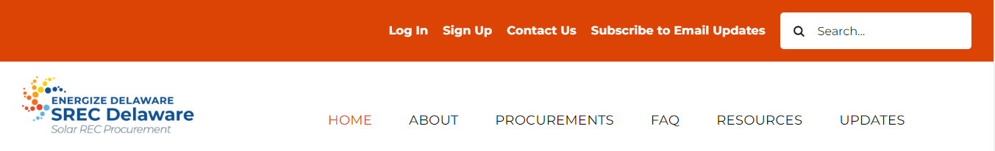
Getting Started
Go to: www.srecdelaware.com, click “Sign Up” on top bar.
Notes:
First step is to sign up on our website. Go to SRECDelaware.com and click sign up.

Slide 23
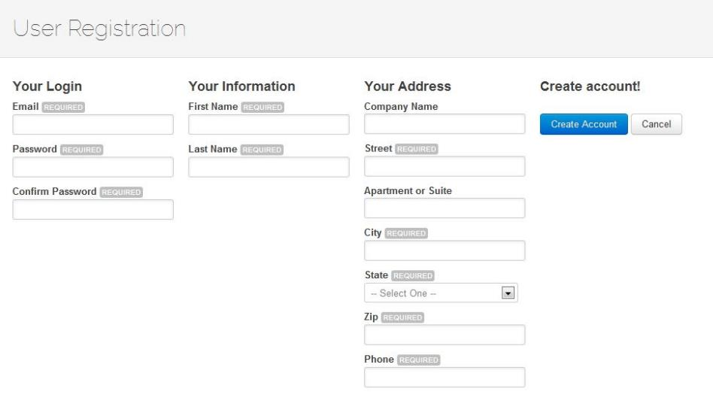
Getting Started
Fill in your contact details, create a password, click “Create Account.”
Notes:
Account Creation Steps:
Fill in your contact details.
Create a password.
Click “Create Account” to complete the process.
Make sure your contact information is accurate to ensure successful account creation.

Slide 24
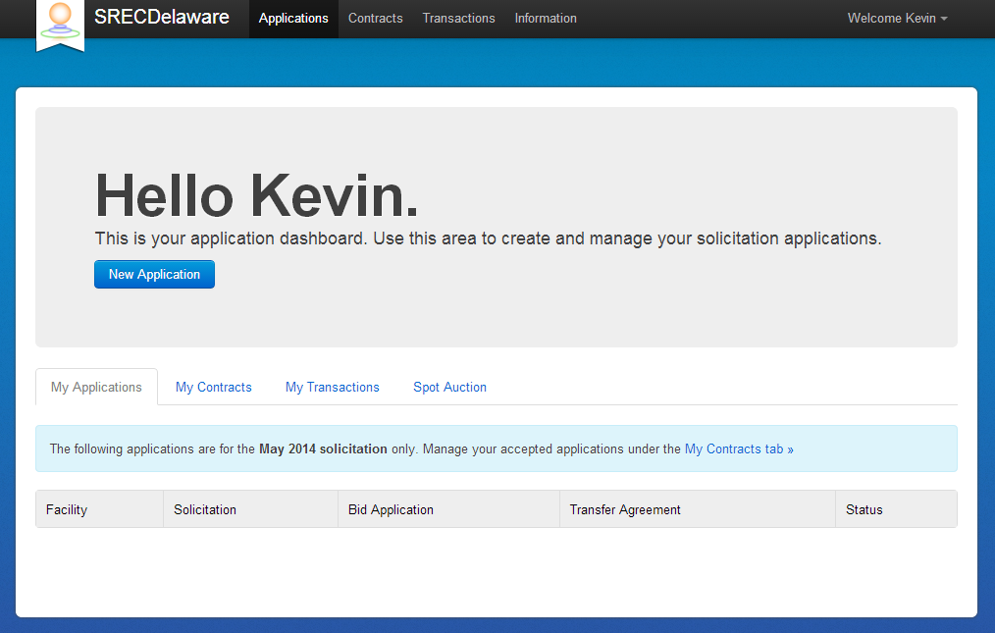
New Applications
Click “New Application.”
Notes:
Starting a New Application:
Once you are logged into the portal, click on “New Application” to begin a new application.
Follow the prompts to ensure all required information is accurately entered.

Slide 25
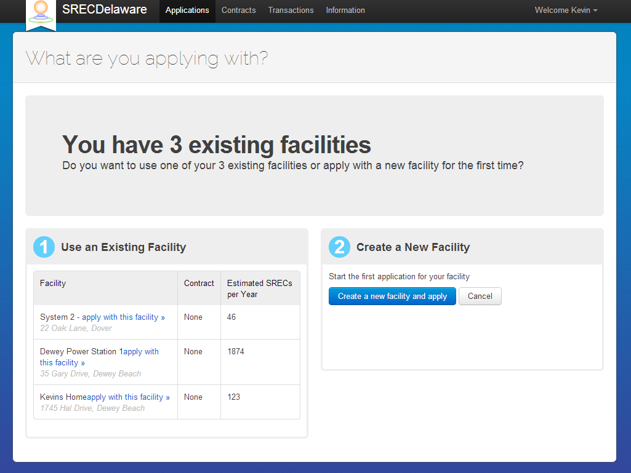
Prior Applications
You can submit a new bid for a facility that was not accepted in a previous procurement.
Contact Customer Service if you want to submit a bid for a facility previously submitted by another party.
Notes:
Resubmitting Bids for Previously Unaccepted Facilities:
If your facility was not accepted in a previous procurement, you can submit a new bid.
How to Resubmit: Log in to your existing account, where you can submit a new bid without needing to re-enter all your facility details.
Third-Party Submissions: If a third party submitted an application on your behalf previously, contact us, and we can transfer that past application to your account, allowing you to manage and resubmit the bid directly.
If you have any questions or need assistance, please reach out to our support team.

Slide 26
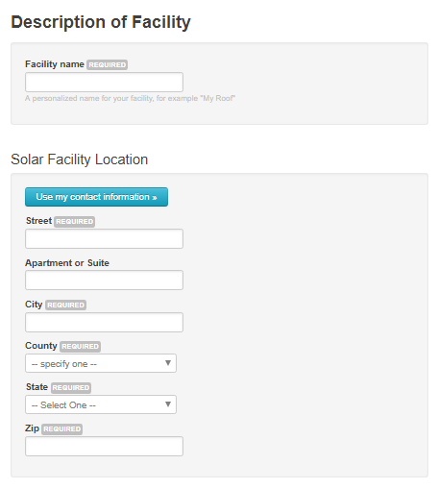
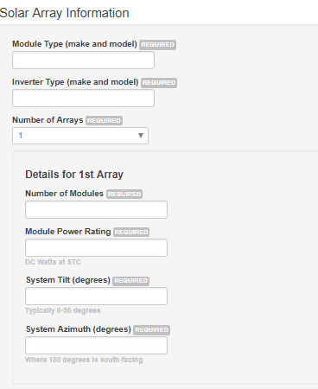
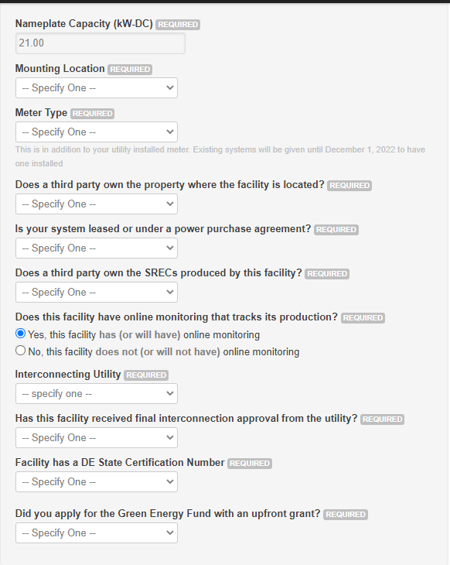
Step #1 – Facility Info
Notes:
Application Checklist and Step 1 Overview:
We are currently creating an application checklist—a document that will outline all the required information needed for the application process. This checklist will be posted on the 2024 Procurement page, eliminating the need to rely on screenshots to prepare for the application window.
Step 1: Facility Information
Step 1 of the application gathers key details about your facility, including:
Location information
Details about the solar array or arrays
Ownership information
This information will determine the tier in which you will be placed for bidding. It is crucial that the information you enter in Step 1 matches the records with the Delaware Public Service Commission (PSC).

Slide 27
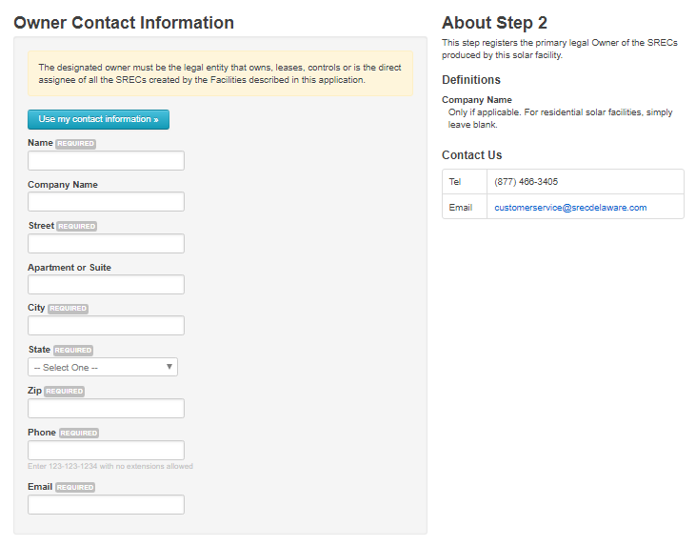
Step #2 – Owner Contact Info
Notes:
Owner Contact Information:
When entering contact information on the application, make sure to provide details for the SREC owner, not the system owner.
If the system owner, property owner, and SREC owner are different parties, you must enter the contact information for the SREC owner in this section.
This ensures that all communications and payments are directed correctly to the owner of the SRECs.

Slide 28
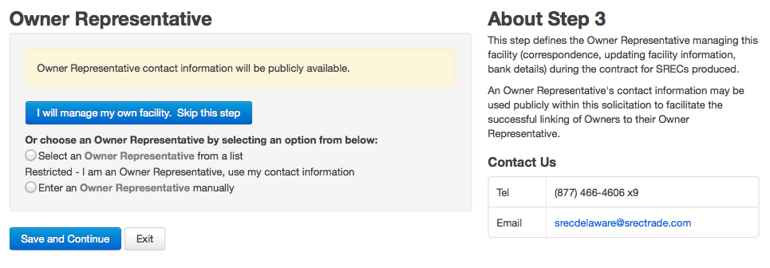
Step #3 – Owner Representative
Select an owner representative, if applicable.
Notes:
Using an Owner Representative:
This section is where you indicate if you are using an owner representative or, if you are an owner representative, where you can identify yourself.
Selecting an Owner Representative: You can choose from a dropdown list of existing owner representatives or enter a new one if not listed.
Optional Role: While using an owner representative is not mandatory, if you choose to do so, you must have their permission before selecting them on your application.
Ensure the correct representative is identified to facilitate smooth communication and application processing.

Slide 29
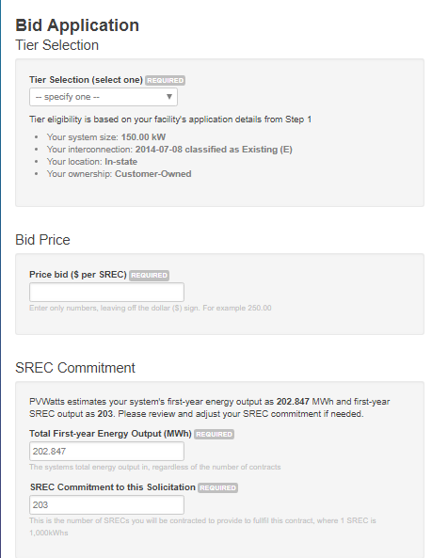
Step #4 – Bid Price
Bids can be any number
Lowest priced bids win
Projects compete within each tier
Notes:
Bid Pricing and Tier Classification Tips:
Bid Price Guidance: Last year, no bids were accepted above $45, so keep this in mind when submitting your bids this year. Remember, any bids over $150 will be automatically rejected.
Competition and Tier Classification: You are competing against other systems within the same tier. Your tier is automatically determined based on the information you provide in Step 1.
Verifying Tier Placement: If you believe your system is not classified in the correct tier, revisit Step 1 and double-check all the system information entered. If the issue persists, please contact us for assistance.
Keep these factors in mind to optimize your bid submission.

Slide 30
Step #4 cont. – SREC Commitment
SREC Commitment: The number of SRECs a facility commits to sell if the bid is successful
Payment for up to 110% of commitment
Projects > 500 kW pay damages for creating less than 80% of commitment
Notes:
SREC Commitment:
The SREC commitment is the number of SRECs a facility agrees to sell if the bid is successful.
Automatic Calculation: We automatically calculate your SREC commitment using the PV Watts estimate calculator. However, you have the option to adjust the commitment. For instance, if your system is optimally positioned and uses high-efficiency panels, you may choose to increase your commitment.
Annual Purchase Allowance: Each year, the program will purchase up to 110% of your commitment. For example, if you commit to 12 SRECs per year, we would pay for up to 13 SRECs annually.
Commitment Shortfalls: There is no penalty for not meeting the commitment unless your system is above 500 kW and produces less than 80% of the commitment. In such cases, you would be required to pay damages on the shortfall.
Ensure your commitment aligns with your system’s expected performance to maximize your benefits.

Slide 31
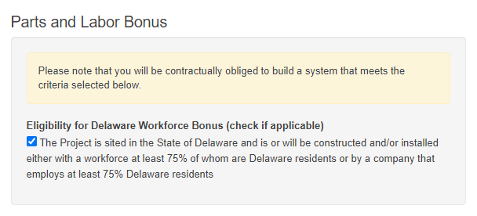
Step #4 cont. – Parts and Labor Bonuses
The facility must match the parts and/or labor bonus indicated on the application, or the contract will be cancelled.
Check your certification number:
DE-#####-SUN-01-PW = Parts & labor
DE-#####-SUN-01-0W = labor only
DE-#####-SUN-01-P0 = Parts only
DE-#####-SUN-01-00 = neither
Contact customer service if you believe you qualify for the Delaware Parts bonus.
Notes:
Delaware Labor and Parts Bonuses:
Delaware Labor Bonus: There is a checkbox on the application to indicate if your system qualifies for the Delaware Labor bonus.
Delaware Parts Bonus: The checkbox for the Delaware Parts bonus is no longer included, as new systems do not typically qualify. To avoid confusion, this option is excluded from the application.
Qualifying for the Parts Bonus: If you believe your system qualifies for the Delaware Parts bonus, please contact customer service. We will verify your eligibility and add the bonus to your application if confirmed.
Make sure to accurately indicate your eligibility for bonuses to ensure you receive the maximum benefits.

Slide 32
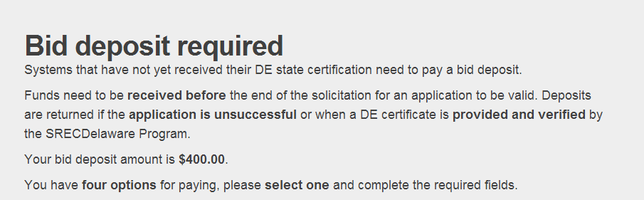
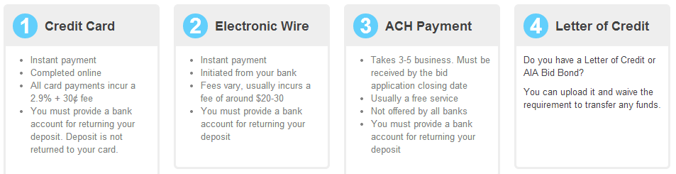
Step #5 – Bid Deposit (if required)
Required for applications that do not already have a Delaware Certification number
$10,000 limit on bid deposits paid by credit card
Notes:
Step 5: Bid Deposit Payment Information
When a Deposit is Required: Step 5 provides instructions on how to pay your bid deposit if it is required. A bid deposit is necessary for applications that do not already have a Delaware Certification number.
Payment Deadline: Funds must be received before the end of the procurement window for your application to be considered valid.
Payment Limits: There is a $10,000 limit on bid deposits paid by credit card. Please ensure your payment is completed in time to avoid any delays in processing your application.
Make sure to follow the payment instructions carefully to ensure your bid remains eligible.

Slide 33
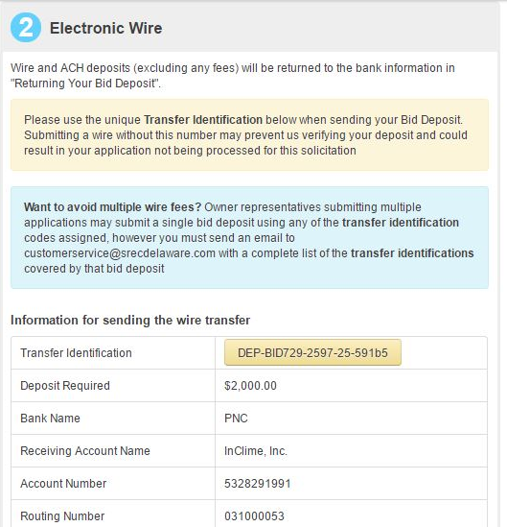
Step #5 – Bid Deposit (continued)
Transfer Identification # used to track payments.
For wire and ACH payments put this Transfer Identification into your wire or ACH at your bank.
Notes:
Paying Your Bid Deposit by ACH or Wire Transfer:
If you choose to pay your bid deposit by ACH or wire transfer, please make sure to include the transfer identification number. This will help us match your payment with your bid and ensure that your application is processed correctly.
Providing the correct transfer information is essential for validating your payment.

Slide 34
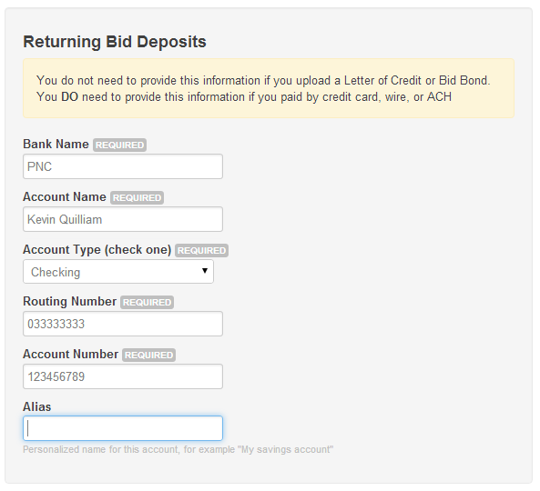
Step #5 – Bid Deposit (continued)
Return information required for wire, ACH, and credit card.
Notes:
Refunding Your Bid Deposit:
If you pay your bid deposit by wire, ACH, or credit card, you will need to provide us with the bank account information where you would like the bid deposit to be returned. This can be either a checking or savings account.
Ensuring we have the correct account details will expedite the return of your bid deposit if applicable.

Slide 35
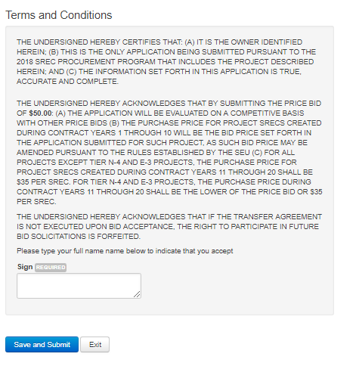
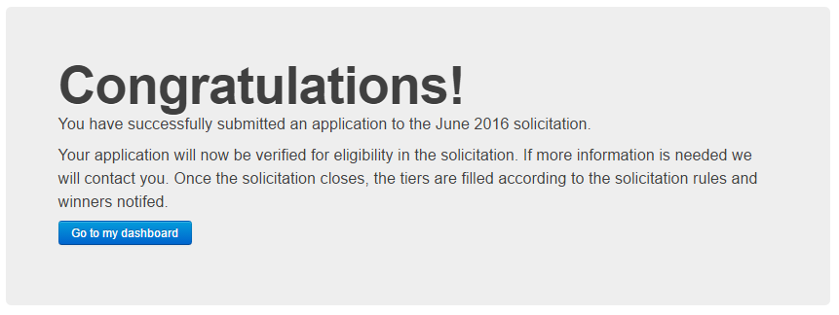
Sign & Submit!
Notes:
The final step is to agree to the terms and conditions, then submit.

Slide 36
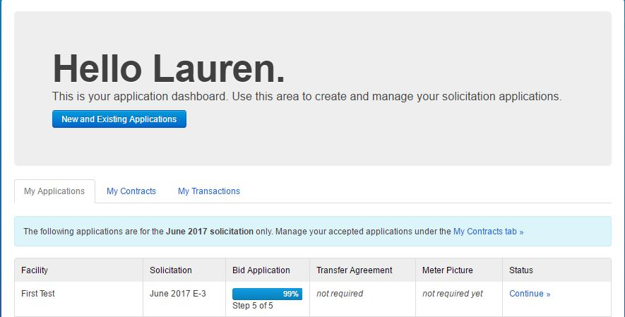
Dashboard
Multiple applications for multiple systems can be managed from your dashboard.
The dashboard will
only show applications from
the 2024 Procurement.
Notes:
Application Review Process:
We review all applications for accuracy, which may take up to two business days. Once your application has been reviewed, you will receive a confirmation that it has been verified.
Please ensure all information is accurate to avoid delays in the review process.

Slide 37
Next steps
If your bid has been accepted, we will provide a deadline for completing the Transfer Agreement and other documents
If your bid is accepted, you must terminate any contract you have with any other SREC broker or aggregator
All facilities will be managed in the SREC Delaware GATS account
Owners must enter solar production readings on the SREC Delaware website
SREC payments will be made by direct deposit
Notes:
Next Steps to Prepare for the 2024 Procurement:
Confirm Application Submission: Verify whether you need to submit your own application. Check with your solar company, as they may plan to submit on your behalf or may have already submitted your system to another program.
Verify Contract Status: Ensure that you are not already under a long-term contract to sell your SRECs, as this could affect your eligibility.
Delaware Certification: If you do not already have a Delaware certification number, submit your application to the DE PSC. Confirm with your solar company to see if they have already registered your system.
Gather Application Information: Use the application checklist to compile all necessary information for a smooth application process.
Review Past Procurement Results: Analyze previous procurement results to help determine a competitive bid price.
Following these steps will help ensure you are fully prepared for the 2024 procurement process.

Slide 38
Questions & Answers
Contact Us:
302.495.9999
customerservice@srecdelaware.com
A recording of this webinar and the slides will be posted on our website:
www.srecdelaware.com

