Slide 1
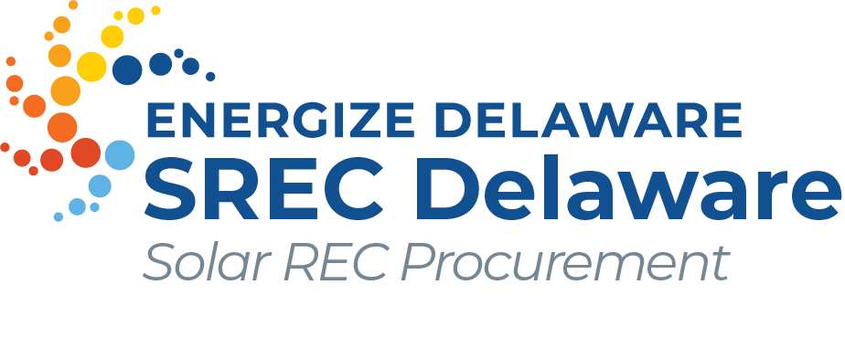
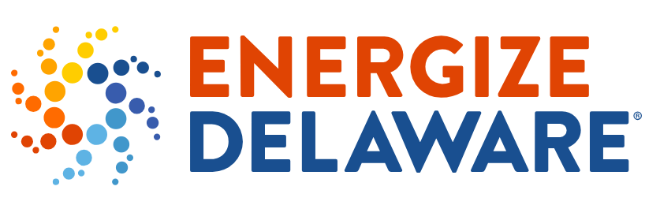

2024 Procurement
Notes:
Thank you for joining the 2024 SREC Delaware Procurement webinar. My name is Bryan Gower, and I am the Program Manager for the SREC Delaware Program. The SREC Delaware program is administered by InClime, on behalf of Energize Delaware, aka DE SEU.
This webinar is intended for homeowners, business owners, and others who haven’t submitted applications to the SREC Delaware program in the past. Please note that there are some Program rules that apply only to large systems. Large is defined as anything over 500 kW in size. The average residential system is about 8-10 kW. We have not included the rules for systems above 500 kW in this webinar, as we wanted to focus on information that is relevant for homeowners, small businesses, nonprofits, etc. If you believe you have a system above 500 kW, I recommend watching the recording of yesterday’s webinar so that you are aware of the requirements for large systems.

Slide 2
Agenda
Solar Renewable Energy Credits (SRECs)
Program Overview
2024 Procurement
Program Requirements
Application Example
Questions & Answers
Notes:
Webinar Information and Agenda:
Recording Availability: This webinar will be recorded and posted on our website under the 2024 Procurement page.
Attendance Guidance: If you already have an SREC Delaware contract and are currently receiving payments through the program, attendance is not required unless you have installed additional panels since your application was accepted. The information presented today does not apply to existing contracts.
Webinar Overview:
SREC Delaware is a program that allows you to sell the Solar Renewable Energy Credits (SRECs) generated by your system.
Agenda:
We will start with an overview of SRECs.
Next, we will review the SREC Delaware Program and the 2024 procurement process specifically.
We will then cover Program Requirements and walk through an application example.
We will conclude with a Q&A session. Feel free to submit your questions at any time, but we will address them at the end of the webinar.

Slide 3
Solar Renewable Energy Credits (SRECs)

Slide 4
Solar Renewable Energy Credits (SRECs)
Renewable Energy Credits (RECs) represent the environmental value of renewable energy
RECs can be bought and sold
RECs allow for an accounting of renewable energy production
SRECs are RECs produced by solar facilities
SRECs are essential for meeting the SREC Delaware Procurement requirements
Notes:
Renewable Energy Credits (RECs): Key Points
Definition of RECs: A Renewable Energy Certificate (REC) is a market-based instrument that represents the environmental attributes associated with one megawatt-hour (MWh) of electricity generated from a renewable energy source, such as wind, solar, biomass, geothermal, or hydropower..
Marketability: A REC separates the environmental attributes of renewable energy generation from the physical electricity. This allows for the sale and trading of the renewable aspect independently of the actual power. RECs create a market-based mechanism that allows entities to meet regulatory compliance and sustainability goals flexibly. They enable companies, utilities, and individuals to support renewable energy production even if they cannot produce it directly.
Tracking Renewable Energy: RECs serve as proof that a specific amount of renewable energy has been generated and added to the grid. By purchasing a REC, the buyer claims the renewable attributes of that energy, contributing to sustainability and carbon reduction goals.
Purpose of the REC Market: RECs enable compliance with Renewable Portfolio Standards (RPS), corporate sustainability goals, and voluntary green energy programs, providing a flexible way for utilities, businesses, and individuals to support and verify renewable energy use.
Solar RECs (SRECs): SRECs are a specific type of REC that are generated exclusively by solar energy facilities, highlighting the environmental value of solar power.
Support for Renewable Portfolio Standards (RPS) Programs: SRECs are essential in meeting the State of Delaware's SREC Procurement prgram and RPS requirements. They help track compliance and ensure that renewable energy targets are met, which drives the adoption of cleaner energy sources.

Slide 5
Solar Renewable Energy Credits (SRECs)
1 SREC = 1,000 kWh of solar production
SRECs are created when your system produces solar electricity,
SRECS are separate from the actual electricity
A typical residential solar facility generates 7-12 SRECs / year
Many states require that electric utilities purchase SRECs in order to meet the state’s renewable energy goals
Delmarva Power is required to purchase SRECs
SREC Delaware is one option to sell the SRECs generated by your system
Notes:
Understanding Solar Renewable Energy Certificates (SRECs):
A Solar Renewable Energy Certificate (SREC) is earned when a solar energy system generates 1,000 kilowatt-hours (kWh) of electricity, equivalent to one megawatt-hour (MWh) of solar production. SRECs are distinct from the actual electricity generated by your solar system; they specifically represent the environmental benefits of producing clean, renewable energy from solar power.
How SRECs Work:
Creation of SRECs: SRECs are created as your solar system generates electricity. For every 1,000 kWh produced, your system earns one SREC.
Separation from Electricity: SRECs are completely separate from the physical electricity your solar panels produce. While the electricity generated by your system is delivered to your utility's grid, the SRECs represent the environmental value of that clean energy production and can be sold independently.
Two Products from Solar Generation: When your solar installation is active, it essentially produces two things, Electricity and SRECS:
Electricity: The electricity your system produces is interconnected with the grid that lowers your electricity bills.
SRECs: These certificates represent the clean energy contribution of your system and can be bought and sold in the market, providing an additional financial incentive for solar owners.
SREC Generation Rates: A typical residential solar system generates between 7 to 12 SRECs annually, depending on the system size, location, and production efficiency.
Utility SREC Requirements: Many states mandate that electric utilities purchase SRECs to meet Renewable Portfolio Standards (RPS), which set goals for the use of renewable energy. Utilities like Delmarva Power are often required to purchase SRECs to comply with state renewable energy goals. By participating the the SREC Delaware program, Delmarva is required to purchase your RECs for the term of the Transfer Agreement.
Selling Your SRECs: Homeowners have several options to sell their SRECs, with SREC Delaware being a prominent market platform. By selling your SRECs, you can generate additional income from your solar installation beyond the savings on your electricity bill.
SRECs provide a financial incentive that not only makes solar more affordable but also supports broader environmental goals by driving demand for renewable energy in compliance-driven markets.

Slide 6
Program Overview

Slide 7
General Overview
The State of Delaware established the SREC Delaware Procurement Program in 2011.
SREC Delaware procures SRECs for Delmarva Power so they can meet their requirements under the Delaware Renewable Portfolio Standard.
Each year a competitive procurement is held, and eligible projects can bid into the program.
Notes:
Introduction to the SREC Delaware Procurement Program:
The State of Delaware launched the SREC Delaware Procurement Program in 2011 to facilitate the purchase of Solar Renewable Energy Certificates (SRECs) for Delmarva Power.
This program plays a crucial role in helping Delmarva Power meet its obligations under the Delaware Renewable Portfolio Standard (RPS).
Each year, SREC Delaware conducts a competitive procurement process, allowing eligible solar projects to submit bids for participation. This provides solar system owners with an opportunity to sell their SRECs to Delmarva Power.

Slide 8
General Overview
Bid Based Applications
Competitively bid contracts- lowest prices will be accepted
Contracts Alpha, Beta & Gamma Tiers = 25 years
First 10 years @ accepted bid price (plus DE parts / labor bonus)
Final 15 years @ $10 / SREC (plus DE parts / labor bonus, as applicable)
Contracts Delta Tier =5 years
5 years @ accepted bid price (plus DE parts / labor bonus, as applicable)
SRECs are purchased as they are generated.
If your application is successful, you will need to enter solar meter readings to receive payment for your SRECs.
Recommended to enter meter readings at least a few times a year.
Notes:
SREC Delaware is a bid based program. This means that contracts are awarded based on bid price. When you submit an application, you will provide information about the system, as well as provide a dollar amount that you would be willing to accept per SREC. The lowest bids in each tier will win contracts.
Four Tiers of Procurement:
Alpha Tier: Small and medium-scale, customer-owned in-state systems (≤350 kW). Most customer owned systems will fall into this category and is the primary focus of this Webinar. We will quickly cover the remaining tiers for informational purposes.
Beta Tier: Large-scale in-state systems (>350 kW but ≤2 MW).
Gamma Tier: Discretionary purchases from systems up to 5 MW, including out-of-state systems and third-party SREC ownership.
Delta Tier (New for 2024): Large-scale in-state systems (>2 MW), with a 5-year contract term.
Contract Terms:
Alpha, Beta, and Gamma Tiers: 25-year contracts, compensated at auction price for the first 10 years, followed by $10 per SREC for the remaining 15 years.
Delta Tier: 5-year contract, compensated at the bid price for all five years.
Procurement Target:
Minimum: 11,000 SRECs.
Maximum: 31,000 SRECs.
Pricing Discretion: Delmarva can exercise price discretion in any tier, rejecting bids that exceed a set price. Non-winning bids cannot fill another tier.
If your application is successful, you will need to enter solar meter readings to receive payment for your SRECs.
We Recommended to enter meter readings at least a few time a year.

Slide 9
Delaware Certification
Your system needs to receive a Delaware Certification number before it can start creating SRECs.
Delaware Certification confirms that a system meets the requirements to generate SRECs that can be sold in Delaware.
Application must be submitted to the Delaware Public Service Commission (DE PSC).
Your solar company may have already registered your system
See our FAQ on applying for Delaware Certification for more information.
Notes:
Delaware Certification Requirements for SREC Generation:
Before your system can begin generating SRECs, it must receive a Delaware Certification number. This certification verifies that your solar system meets the necessary requirements to produce SRECs eligible for sale in Delaware.
To obtain certification, you must submit an application to the Delaware Public Service Commission (DE PSC). Often, your solar installer may have already registered your system, so be sure to check with them first.
For more information on the certification process, please refer to our FAQ on applying for Delaware Certification.

Slide 10
Delaware Parts and Labor Bonuses
Bonuses available for systems that use DE labor, or have DE manufactured solar panels
Eligibility for bonuses is confirmed by the Delaware Public Service Commission
10% parts and 10% labor bonuses apply to payments only
Example: Successful bid at $30/SREC, with DE labor associated with the certification number, is paid $33/SREC for first 10 years
Contract award preference for DE parts and labor in the event of a bid tie
Notes:
Bonuses for Delaware Labor and Parts:
Eligibility: Bonuses are available for solar systems that use Delaware labor or have solar panels manufactured in Delaware. However, since Delaware no longer manufactures solar parts, systems can only qualify for the Delaware parts bonus if they are existing installations or use older panels previously manufactured in the state.
Verification: Eligibility for these bonuses is confirmed by the Delaware Public Service Commission (DE PSC). System owners must provide the necessary documentation to verify eligibility, which will be noted in the system’s certification number once confirmed.
Bonus Calculation: If a system qualifies for either bonus, it will receive an additional 10% per SREC for each qualifying bonus.
Example: A successful bid at $30 per SREC with Delaware labor associated with the certification number would receive $33 per SREC for the first 10 years.
Bid Tie Preference: In the event of a bid tie, preference is given to bids with Delaware parts and labor.
Make sure to provide the necessary documentation to take full advantage of these bonuses.

Slide 11
Owner Representatives
Bids can be submitted by the owner of the system, or by an Owner Representative. ​
SREC owners or Owner Representatives can manage successful SREC contracts. ​
SREC owners can change or remove Owner Representative oversight at any time. ​
Some solar installation companies serve as owner representatives & submit customer applications, others require that customers submit their own applications.
Notes:
Bid Submission and Management of SREC Contracts:
Who Can Submit Bids: Bids can be submitted by either the system owner or an Owner Representative.
Managing SREC Contracts: Both SREC owners and Owner Representatives have the authority to manage successful SREC contracts.
Flexibility with Representatives: SREC owners can change or remove Owner Representative oversight at any time, allowing for flexible management of their contracts.
Role of Solar Companies: Some solar installation companies act as Owner Representatives and handle the application process for their customers, while others require customers to submit their own applications.
Submitting Your Own Application: If you do not have an existing relationship with a solar company that will submit your application, you will need to submit it yourself. Currently, we are not aware of any Owner Representatives who will submit applications for systems they did not install.
Ensure you have a clear plan for submitting your application and managing your SREC contract.

Slide 12
2024 Procurement

Slide 13
Timeline
Nov 4th @ 9 am
Application window opens
Nov 15th @ 5 pm
Application window closes
Results announced
Once the results are announced, winning applicants will be sent
instructions on how to manage their contracts.
Notes:
Procurement Timeline:
Application Period: Applications will be accepted during a two-week window from November 4th to November 15th, 2024.
Results Announcement: Approximately one month after the application window closes, the procurement results will be announced.
Next Steps for Successful Applicants: Once the results are published, successful applicants will receive detailed instructions on how to manage their contracts.
Please mark these dates and ensure your application is submitted on time to participate in the 2024 procurement process.

Slide 14
Tiers
Minimum of 11,000 SRECs procured - Maximum of 31,000 SRECs procured
New: systems with Interconnection Approval To Operate date of September 29th, 2023, or later.
Contract: 25-year contract structure remains the same for Alpha, Beta, and Gamma Tiers
Tier | Nameplate rating (DC at STC) | Description | Contract Term | #SRECs / Year
Alpha | ≤ 350 kW | Customer owned, new, in state | 25-year | 6,000
Beta | 350 kW ≤ 2 MW | New, in state | 25-year | 5,000
Gamma | < 5 MW | In state systems with 3rd party SREC ownership All existing systems Qualifying out of state systems | 25-year | 10,000
Delta | >2MW | New, in state | 5-year | 10,000
Notes:
The 2024 procurement consists of four tiers.
Delmarva intends to procure between 11,000 – 25,000 SRECs / year through this procurement.
Four Tiers of Procurement. Most small scale solar projects will apply for Alpha tier. To provide a brief summary of all the tiers:
Alpha Tier: Small and medium-scale, customer-owned in-state systems (≤350 kW).
Beta Tier: Large-scale in-state systems (>350 kW but ≤2 MW).
Gamma Tier: Discretionary purchases from systems up to 5 MW, including out-of-state systems and third-party SREC ownership.
Delta Tier (New for 2024): New Large-scale in-state systems (>2 MW). The Delta Tier is awarded a 5-year contract term.

Slide 15
Bid Prices
Bid price is the $ / SREC you would accept as payment
In 2023 the average accepted bid price was: $30.51 / SREC
Delmarva has the right to exercise price discretion and reject bids
Bids above the Alternative Compliance Price of $150 will be automatically rejected
You can see past procurement results by going to the procurement’s page on our website and scrolling to the “Results” section.
Notes:
Bid Price Guidance:
Understanding Your Bid Price: When submitting a bid, your bid price is the dollar amount per SREC that you are willing to accept as payment.
Historical Context: In 2023, the average accepted bid price was $30.51 per SREC, which can serve as a reference point for this year's bidding.
Price Discretion and Rejection: Delmarva Power retains the right to exercise price discretion and may reject bids that do not meet their criteria. Additionally, any bids exceeding the Alternative Compliance Price of $150 will be automatically rejected.
Accessing Past Results: For more insights on past procurement results, please visit the specific procurement page on our website and scroll down to the 'Results' section.
Keep these factors in mind when determining your bid price to increase your chances of success.

Slide 16
Award Process
Step 1
Program Administrator reviews all applications
Step 2
Computer sorts bids low to high in each tier
Step 3
Lowest bids in each tier are awarded contracts
Notes:
Step-by-Step Bid Review Process:
Bid Review by Program Administrator: In the first step, the Program Administrator reviews all submitted bids. This includes verifying that the facility address is correct, ensuring the facility is not already enrolled in the SREC Delaware program, and confirming that the SREC commitment is reasonable based on the system size.
Bid Sorting: Next, a computer sorts all the bids from lowest to highest within each tier.
Contract Awards: Finally, the lowest bids in each tier are awarded contracts, ensuring that the most cost-effective bids are selected.

Slide 17
Award Process – Tie Scenario
Tie Scenario: if multiple bids at the same price oversubscribe a tier
Systems with DE Labor and/or Parts would be selected over systems without either bonus
If a tie remains, the systems involved in the tie may need to submit revised bids
We will contact you if you need to rebid.
Notes:
Handling Bid Ties in the SREC Procurement Process:
A tie can occur when multiple bids at the same price oversubscribe a tier. This means that two or more bids at the same price are competing for the final spot within that tier.
To minimize the chance of a tie, bids can be submitted in dollars and cents. Here’s how ties will be managed if they do happen:
Tie Scenario: If multiple bids at the same price oversubscribe a tier, the following steps are taken:
Systems that utilize Delaware labor and/or Delaware parts are prioritized and will be selected over those without these bonuses.
If a tie still exists, the tied systems may be asked to submit revised bids.
Next Steps: If you need to rebid due to a tie, we will reach out to you directly with instructions.

Slide 18
Program Requirements

Slide 19
Basic Requirements
Projects must have or be eligible for DE certification
Applicants are responsible for obtaining DE certification #s
Projects must be operational within 12 months of contract award date
Projects under 500 kW must have revenue grade meters or revenue grade online monitoring
Projects 500 kW or greater must have revenue grade online monitoring installed
Notes:
Eligibility and Requirements for Project Participation:
Delaware Certification: All projects must either have or be eligible for Delaware certification. It is the applicant’s responsibility to obtain a Delaware certification number. If you have not yet registered with the Delaware Public Service Commission (PSC) and have questions about the registration process, please refer to the FAQ section on our website or contact the DE PSC directly.
Certification and Bidding: You do not need a Delaware certification number to submit a bid. However, if your bid is successful, you must provide your certification number before you can finalize your system and begin receiving payments.
Project Operation Timeline: All projects must be operational within 12 months of the contract award date.
Metering Requirements: A revenue-grade meter or inverter is required to track production. Projects under 500 kW must have revenue-grade meters or revenue-grade online monitoring. Most new meters meet the revenue-grade requirement, but please contact us if you have any questions about whether your meter or inverter qualifies.

Slide 20
One Contract – Multiple Facilities
Applicants must aggregate facilities together under one contract if they:
Are on the same parcel of land OR
Share a utility interconnection point
Exceptions made for partial fills from previous procurements.
Notes:
Aggregation Requirements for Multiple Facilities:
Applicants must aggregate their facilities under one contract if they:
Are located on the same parcel of land, OR
Share a utility interconnection point.
Exceptions may apply for partial fills from previous procurements.
Example Scenario: Consider an office complex with multiple buildings, each having its own solar facility. In this case, all the facilities would need to be aggregated into a single bid. Afterward, you would contact our customer service team, and we will make adjustments to ensure that each facility owner receives the correct number of SRECs from the shared contract.
If you have any questions about aggregation, please reach out to our team for assistance.

Slide 21
Bid Deposits
Required if system does not yet have DE certification
= $100/kW of nameplate capacity
Rounded using standard rounding rules
Example: 8.7 kW system = $900 owed for bid deposit
Bid deposit returned if application NOT successful OR once facility provides DE certification
Bid deposit forfeited if you have a successful application but do not follow through with the contract
Notes:
Bid Deposit Requirements for Systems Without Delaware Certification:
Bid Deposit Amount: If your system does not yet have a Delaware certification, a bid deposit is required at the time of application. The deposit is calculated as $100 per kW of nameplate capacity, rounded using standard rounding rules.
Example: For an 8.7 kW system, the bid deposit would be $900.
Refund Policy: The bid deposit will be returned if your application is not successful or once your facility provides a Delaware certification number.
Forfeiture: The bid deposit will be forfeited if your application is successful but you do not follow through with the contract.
If you do not have a Delaware certification number when submitting your application, ensure that you include the required bid deposit to proceed.

Slide 22
Application Example
Notes:
Now we will move on to an application example.

Slide 23
Application Overview
Application window:
Monday November 4th, 9:00am – Friday November 15th, 5:00pm
All applications must be submitted online
One application per facility
Applications can be saved and returned to before final submission
Applications can be submitted by facility owner or an owner representative
Notes:
Application Window and Submission Details:
Application Period: The application window opens on Monday, November 4th at 9:00 am and closes on Friday, November 15th at 5:00 pm.
Submission Process: All applications must be submitted online. Each facility is allowed one application.
Save and Return: Applications can be saved and completed at a later time before final submission.
Who Can Submit: Applications can be submitted by either the facility owner or a designated owner representative.
Ensure your application is completed and submitted within the specified timeframe.

Slide 24
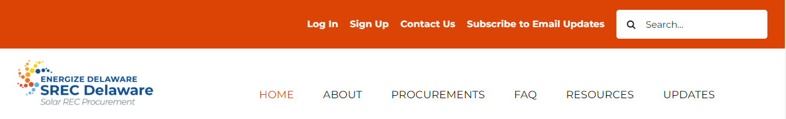
Getting Started
Go to: www.srecdelaware.com, click “Sign Up” on top bar.
Notes:
First step is to sign up on our website. Go to SRECDelaware.com and click sign up.

Slide 25
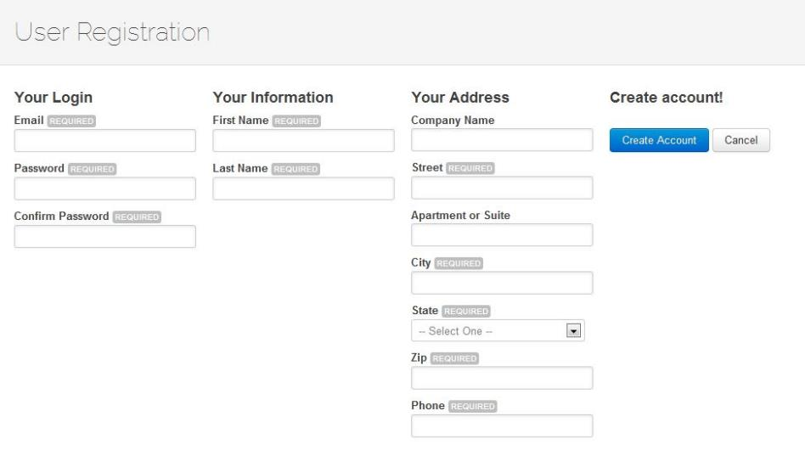
Getting Started
Fill in your contact details, create a password, click “Create Account.”
Notes:
Fill in your contact details, create a password, click “Create Account.”

Slide 26
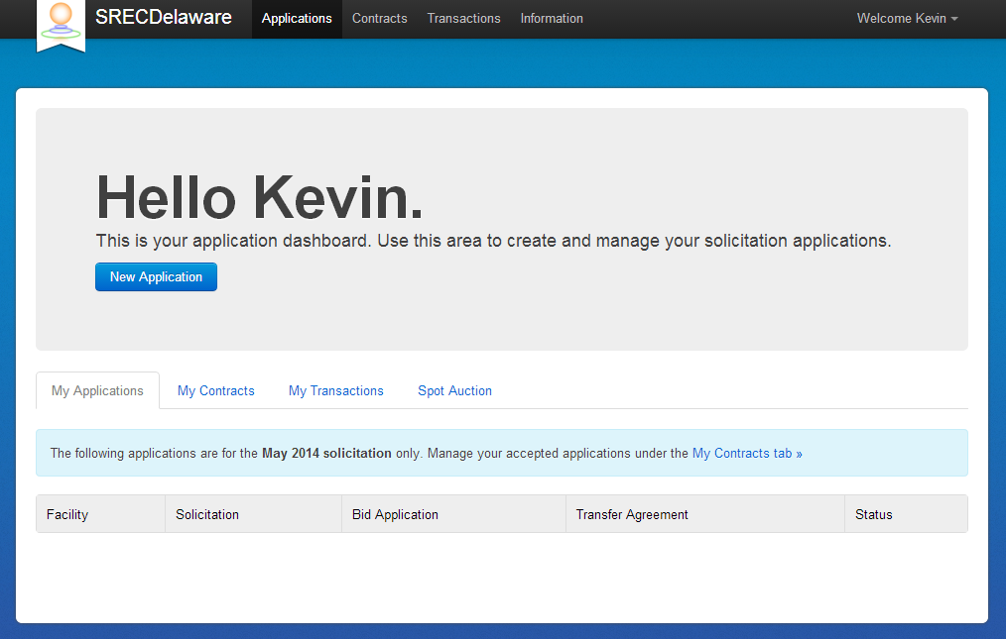
New Applications
Click “New Application.”
Notes:
Once you are logged into the portal – click new application to start a new application.

Slide 27
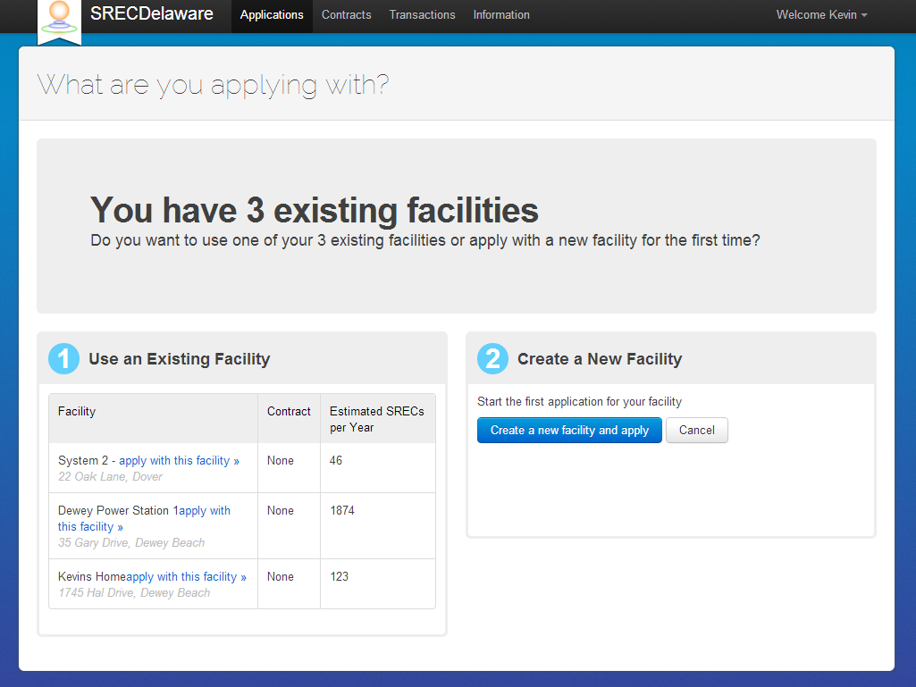
Prior Applications
You can submit a new bid for a facility that was not accepted in a previous procurement.
Contact Customer Service if you want to submit a bid for a facility previously submitted by another party.
Notes:
Resubmitting Bids for Previously Unaccepted Facilities:
If your facility was not accepted in a previous procurement, you can submit a new bid.
How to Resubmit: Log in to your existing account, where you can submit a new bid without needing to re-enter all your facility details.
Third-Party Submissions: If a third party submitted an application on your behalf previously, contact us, and we can transfer that past application to your account, allowing you to manage and resubmit the bid directly.
If you have any questions or need assistance, please reach out to our support team.

Slide 28
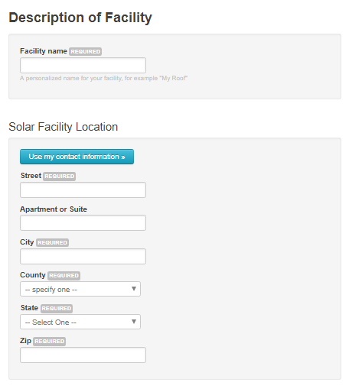
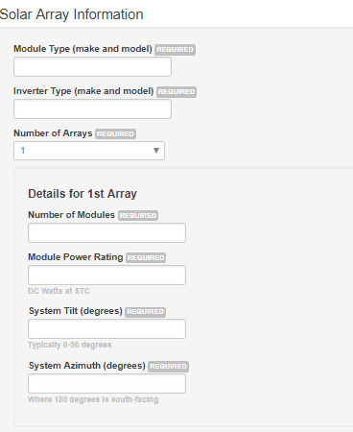
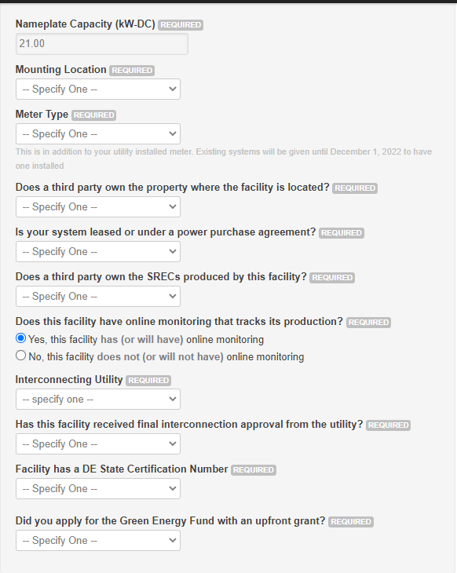
Step #1 – Facility Info
Notes:
Application Checklist and Step 1 Overview:
We are currently creating an application checklist—a document that will outline all the required information needed for the application process. This checklist will be posted on the 2024 Procurement page, eliminating the need to rely on screenshots to prepare for the application window.
Step 1: Facility Information
Step 1 of the application gathers key details about your facility, including:
Location information
Details about the solar array or arrays
Ownership information
This information will determine the tier in which you will be placed for bidding. It is crucial that the information you enter in Step 1 matches the records with the Delaware Public Service Commission (PSC).

Slide 29
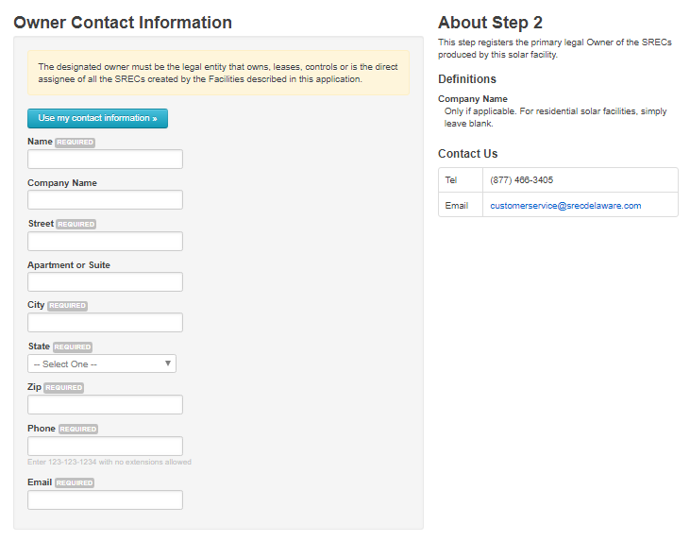
Step #2 – Owner Contact Info
Notes:
Owner Contact Information:
When entering contact information on the application, make sure to provide details for the SREC owner, not the system owner.
If the system owner, property owner, and SREC owner are different parties, you must enter the contact information for the SREC owner in this section.
This ensures that all communications and payments are directed correctly to the owner of the SRECs.

Slide 30
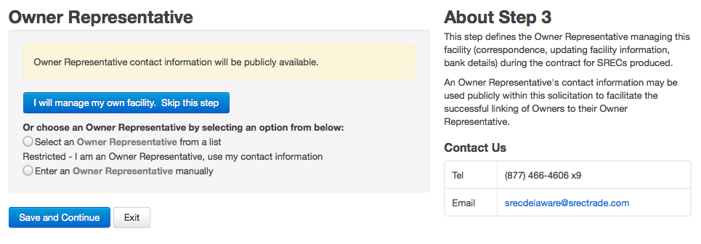
Step #3 – Owner Representative
Select an owner representative, if applicable.
Notes:
Using an Owner Representative:
This section is where you indicate if you are using an owner representative or, if you are an owner representative, where you can identify yourself.
Selecting an Owner Representative: You can choose from a dropdown list of existing owner representatives or enter a new one if not listed.
Optional Role: While using an owner representative is not mandatory, if you choose to do so, you must have their permission before selecting them on your application.
Ensure the correct representative is identified to facilitate smooth communication and application processing.

Slide 31
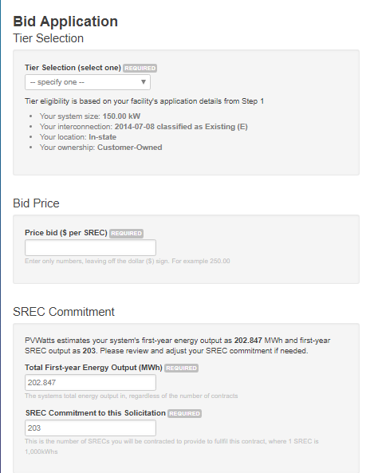
Step #4 – Bid Price
Bids can be any number
Lowest priced bids win
Projects compete within each tier
Notes:
Bid Pricing and Tier Classification Tips:
Bid Price Guidance: Last year, no bids were accepted above $45, so keep this in mind when submitting your bids this year. Remember, any bids over $150 will be automatically rejected.
Competition and Tier Classification: You are competing against other systems within the same tier. Your tier is automatically determined based on the information you provide in Step 1.
Verifying Tier Placement: If you believe your system is not classified in the correct tier, revisit Step 1 and double-check all the system information entered. If the issue persists, please contact us for assistance.
Keep these factors in mind to optimize your bid submission.

Slide 32
Step #4 cont. – SREC Commitment
SREC Commitment: The number of SRECs a facility commits to sell if the bid is successful
Payment for up to 110% of commitment
Projects > 500 kW pay damages for creating less than 80% of commitment
Notes:
SREC Commitment:
The SREC commitment is the number of SRECs a facility agrees to sell if the bid is successful.
Automatic Calculation: We automatically calculate your SREC commitment using the PV Watts estimate calculator. However, you have the option to adjust the commitment. For instance, if your system is optimally positioned and uses high-efficiency panels, you may choose to increase your commitment.
Annual Purchase Allowance: Each year, the program will purchase up to 110% of your commitment. For example, if you commit to 12 SRECs per year, we would pay for up to 13 SRECs annually.
Commitment Shortfalls: There is no penalty for not meeting the commitment unless your system is above 500 kW and produces less than 80% of the commitment. In such cases, you would be required to pay damages on the shortfall.
Ensure your commitment aligns with your system’s expected performance to maximize your benefits.

Slide 33
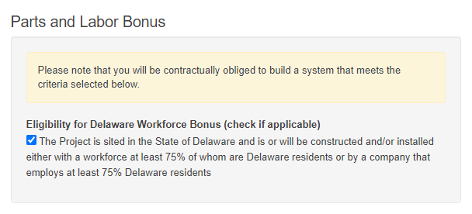
Step #4 cont. – Parts and Labor Bonuses
The facility must match the parts and/or labor bonus indicated on the application, or the contract will be cancelled.
Check your certification number:
DE-#####-SUN-01-PW = Parts & labor
DE-#####-SUN-01-0W = labor only
DE-#####-SUN-01-P0 = Parts only
DE-#####-SUN-01-00 = neither
Contact customer service if you believe you qualify for the Delaware Parts bonus.
Notes:
Delaware Labor and Parts Bonuses:
Delaware Labor Bonus: There is a checkbox on the application to indicate if your system qualifies for the Delaware Labor bonus.
Delaware Parts Bonus: The checkbox for the Delaware Parts bonus is no longer included, as new systems do not typically qualify. To avoid confusion, this option is excluded from the application.
Qualifying for the Parts Bonus: If you believe your system qualifies for the Delaware Parts bonus, please contact customer service. We will verify your eligibility and add the bonus to your application if confirmed.
Make sure to accurately indicate your eligibility for bonuses to ensure you receive the maximum benefits.

Slide 34
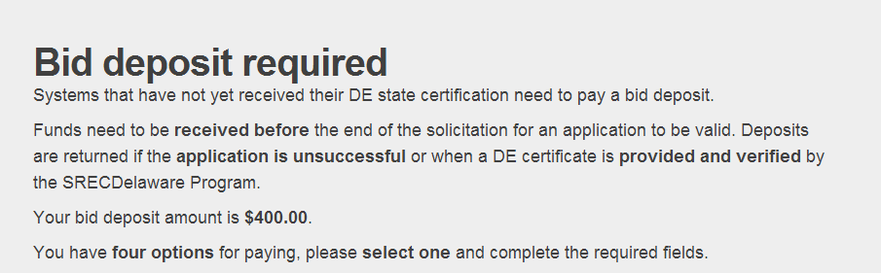
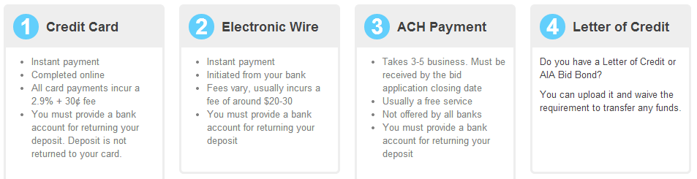
Step #5 – Bid Deposit (if required)
Required for applications that do not already have a Delaware Certification number
$10,000 limit on bid deposits paid by credit card
Notes:
Step 5: Bid Deposit Payment Information
When a Deposit is Required: Step 5 provides instructions on how to pay your bid deposit if it is required. A bid deposit is necessary for applications that do not already have a Delaware Certification number.
Payment Deadline: Funds must be received before the end of the procurement window for your application to be considered valid.
Payment Limits: There is a $10,000 limit on bid deposits paid by credit card. Please ensure your payment is completed in time to avoid any delays in processing your application.
Make sure to follow the payment instructions carefully to ensure your bid remains eligible.

Slide 35
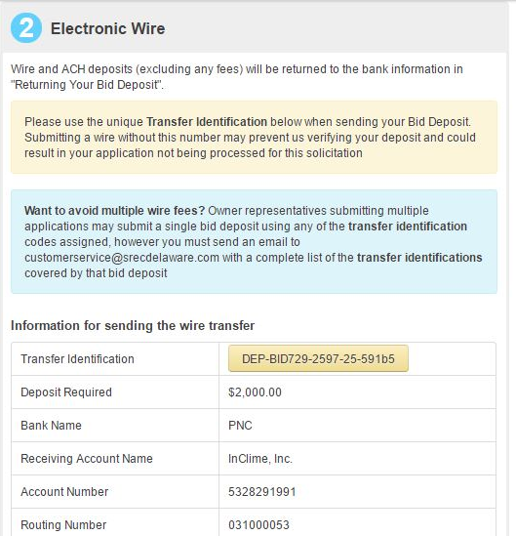
Step #5 – Bid Deposit (continued)
Transfer Identification # used to track payments.
For wire and ACH payments put this Transfer Identification into your wire or ACH at your bank.
Notes:
Paying Your Bid Deposit by ACH or Wire Transfer:
If you choose to pay your bid deposit by ACH or wire transfer, please make sure to include the transfer identification number. This will help us match your payment with your bid and ensure that your application is processed correctly.
Providing the correct transfer information is essential for validating your payment.

Slide 36
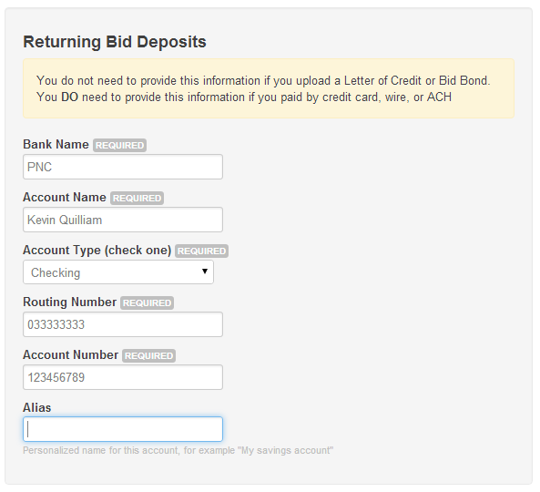
Step #5 – Bid Deposit (continued)
Return information required for wire, ACH, and credit card.
Notes:
Refunding Your Bid Deposit:
If you pay your bid deposit by wire, ACH, or credit card, you will need to provide us with the bank account information where you would like the bid deposit to be returned. This can be either a checking or savings account.
Ensuring we have the correct account details will expedite the return of your bid deposit if applicable.

Slide 37
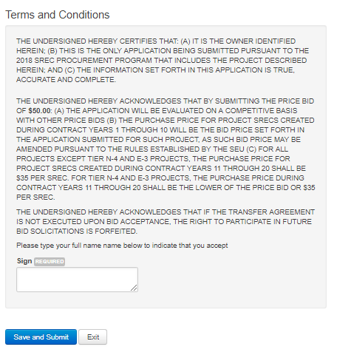
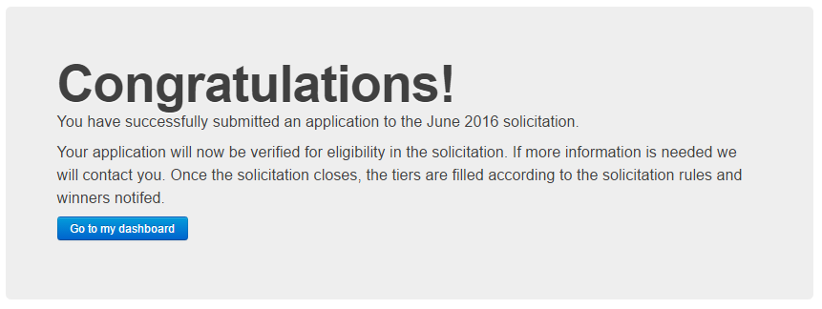
Sign & Submit!
Notes:
The final step is to agree to the terms and conditions, then submit.

Slide 38
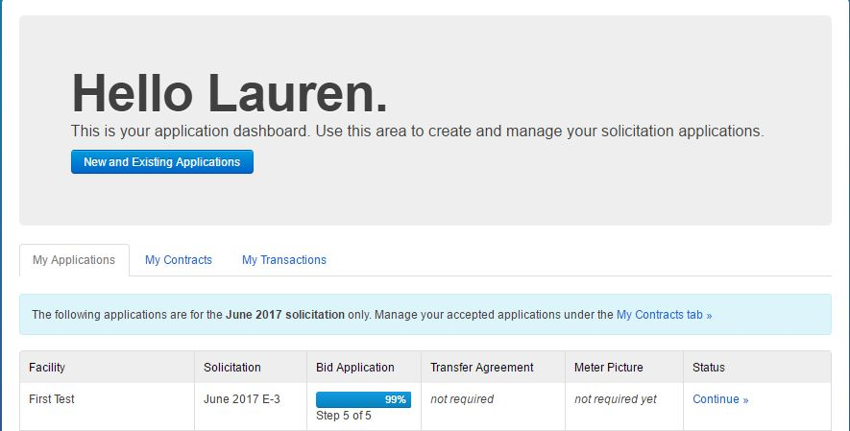
Dashboard
Multiple applications for multiple systems can be managed from your dashboard.
The dashboard will
only show applications from
the 2024 Procurement.
Notes:
Application Review Process:
We review all applications for accuracy, which may take up to two business days. Once your application has been reviewed, you will receive a confirmation that it has been verified.
Please ensure all information is accurate to avoid delays in the review process.

Slide 39
Next steps – before application window
Confirm that you will need to submit your own application
Confirm that you are not already under long term contract to sell your SRECs
Submit your DE certification application to the DE PSC if you do not already have a certification number
Gather necessary application information – use the application checklist!
Review past procurement results to decide on a bid price
Notes:
Next Steps to Prepare for the 2024 Procurement:
Confirm Application Submission: Verify whether you need to submit your own application. Check with your solar company, as they may plan to submit on your behalf or may have already submitted your system to another program.
Verify Contract Status: Ensure that you are not already under a long-term contract to sell your SRECs, as this could affect your eligibility.
Delaware Certification: If you do not already have a Delaware certification number, submit your application to the DE PSC. Confirm with your solar company to see if they have already registered your system.
Gather Application Information: Use the application checklist to compile all necessary information for a smooth application process.
Review Past Procurement Results: Analyze previous procurement results to help determine a competitive bid price.
Following these steps will help ensure you are fully prepared for the 2024 procurement process.

Slide 40
Next steps – after application window
Approximately 1 month after procurement window closes, results will be announced.
We will provide a deadline for completing the Transfer Agreement and other documents
You must terminate any contract you have with any other SREC broker or aggregator
Please allow 1-2 months for our team to register your facility with the SREC Tracking registry after you sign the necessary documents.
Notes:
Next Steps After a Winning Bid:
Notification of Winning Bid: If your bid is successful, you will receive further instructions from us regarding the next steps.
Announcement of Results: Procurement results will be announced approximately one month after the procurement window closes.
Document Deadlines: We will provide a deadline for completing the Transfer Agreement and any other required documents.
Contract Termination: You must terminate any existing contracts with other SREC brokers or aggregators.
Facility Registration: After signing the necessary documents, please allow 1-2 months for our team to register your facility with the SREC Tracking registry.
Following these steps will ensure a smooth transition into the program after winning a bid.

Slide 41
Next steps – after application window
SREC owners must enter solar production readings on the SREC Delaware website
SREC payments will be made by direct deposit
Notes:
SREC Reporting and Payments:
Production Reporting: SREC owners are required to enter their solar production readings on the SREC Delaware website.
Payment Method: SREC payments will be made via direct deposit.
Ensure timely reporting of your production data to facilitate accurate and prompt payment.

Slide 42
Questions & Answers
Contact Us:
302.495.9999
customerservice@srecdelaware.com
A recording of this webinar and the slides will be posted on our website:
www.srecdelaware.com

